Slide 1
CS 419: Production Rendering Radiosity
Eric Shaffer

Slide 2
Radiosity
Radiosity solves the rendering equation very efficiently
Can generate global illumination effects like color-bleeding
Can render a reasonably realistic scene in real-time
But only for diffuse surfaces and diffuse lighting

Slide 3
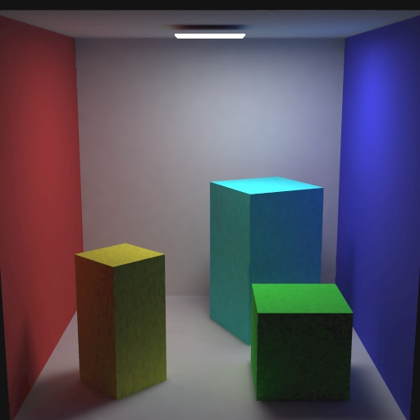
Cornell Box
red hue
blue hue

Slide 4
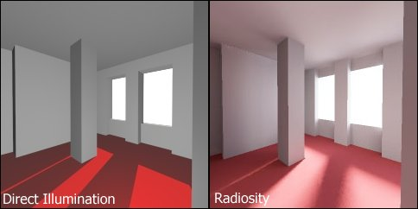
Example

Slide 5
Diffuse Interreflections
Use only Lambertian surfaces and emitters
Radiance independent of viewing direction
Consider total power leaving per unit area of a surface
Can generate soft shadows
Initially used methods from heat transfer literature

Slide 6
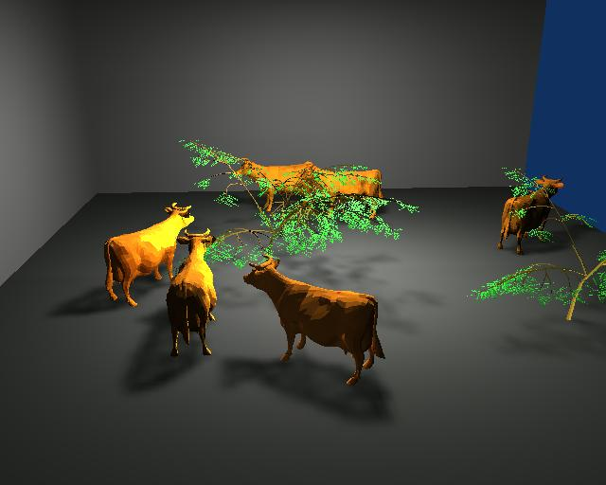
Thermal Transfer Literature
Perry, R.L., and Speck, E.P., 1962, "Geometric factors for thermal radiation exchange between cows and their surroundings," Trans. Am. Soc. Ag. Engnrs., General Ed., vol. 5, no. 1, pp. 31-37.
Used mechanical integrator to measure factors from various wall elements to a cow, and presents some results for size of equivalent sphere that gives same factor as cow. It is found that the sphere origin should be placed at one-fourth of the withers to pin-bone distance behind the withers, at a height above the floor of two-thirds of the height at the withers, and that the equivalent sphere radius should be 1.8, 2.08, or 1.78 times the heart girth for exchange with the floor and ceiling, sidewalls, or front and back walls, respectively. Also discusses exchange between cows and entire bounding walls, floor and ceiling, and between parallel cows.

Slide 7
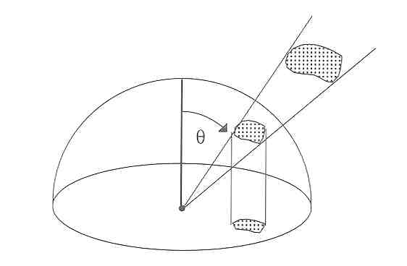
Physics Review: Irradiance & Radiosity
Irradiance E
is the power received per unit surface area
Units: W/m²
Radiosity
Power per unit area leaving the surface
Like irradiance

Slide 8
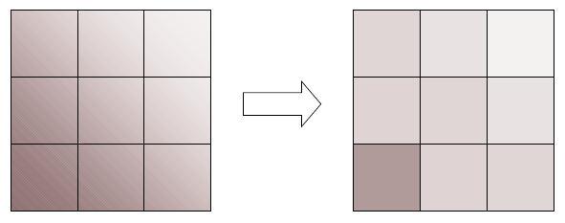
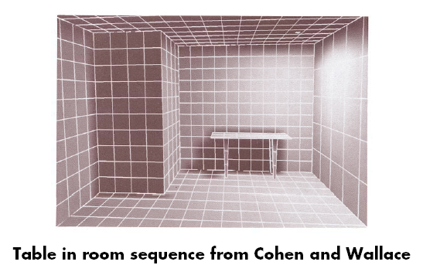
Planar Piecewise Constancy
Subdivide scene into small uniform polygons

Slide 9
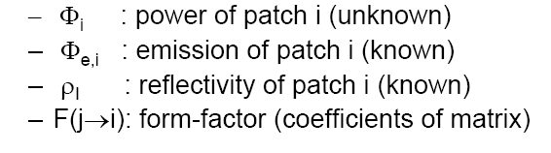
Power Equation
Power from each polygon:
What is the typo in the equation?
Linear System of Equations:

Slide 10
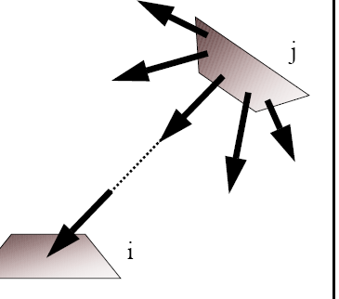
Form Factor
F_{j→i}= fraction of power emitted by j received by I
Elements of the Form Factor
Area
If i is smaller it receives less power
Orientation
If i faces j it receives more
Distance
if i is farther away it receives less power

Slide 11
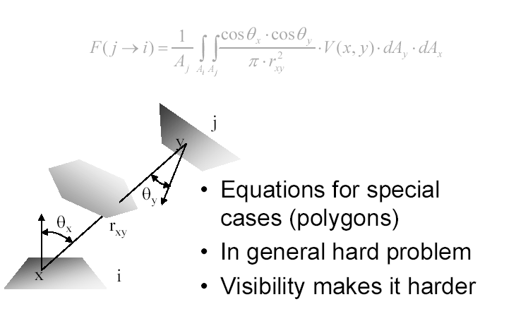
Form Factors

Slide 12
Form Factors

Slide 13
Form Factor Computation
Schroeder and Hanrahan derived an analytic expression for polygonal surfaces.
In general, computing double integral is hard.
Use Monte Carlo Integration.
Most modern (21st century) implementations use sampling

Slide 14
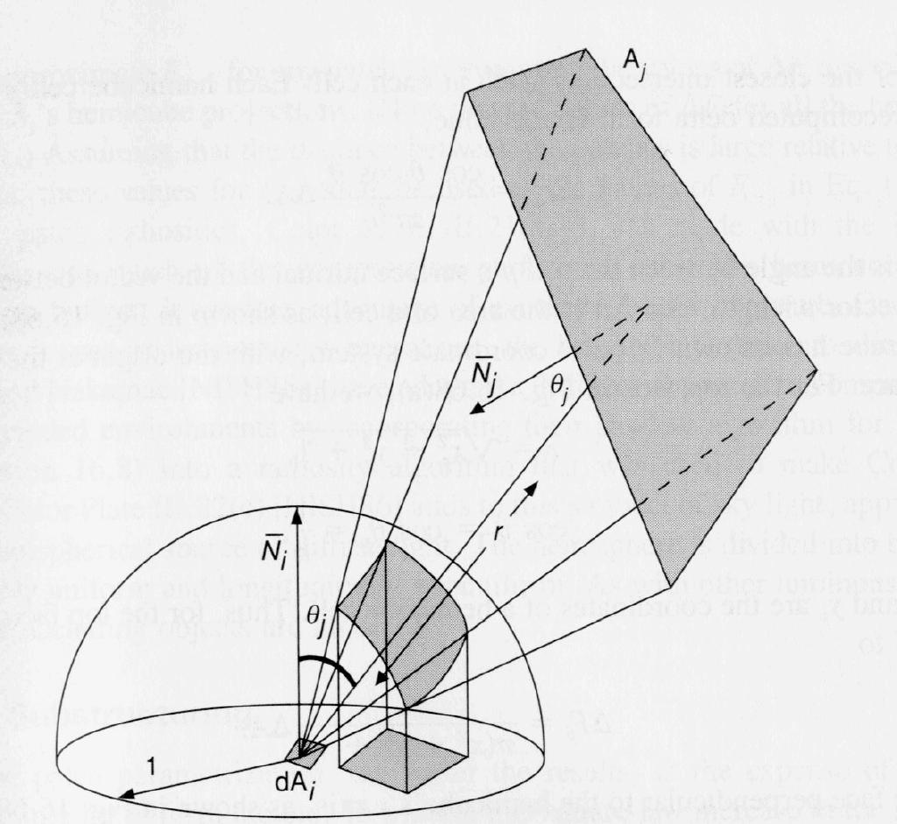
Form Factor – Computation
Spherical projections to model form factor
Project polygon A_{j} on unit hemisphere centered at A_{i}
Project this projection to base of hemisphere

Slide 15
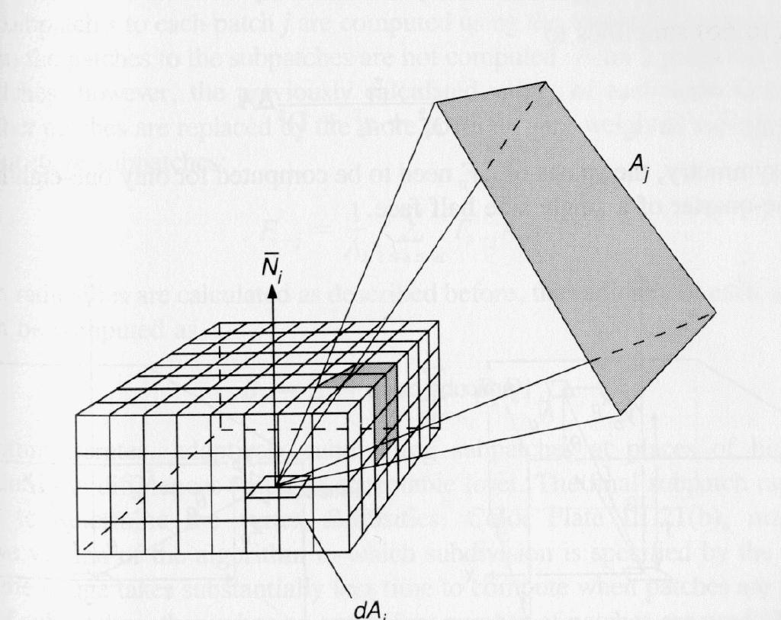
Form Factor –Computation
Hemicube allows faster computations
Analytic solution of hemisphere is expensive
Use rectangular approximation, hemicube
cosine terms for top and sides are simplified
Dimension of 50 – 200 squares is good

Slide 16
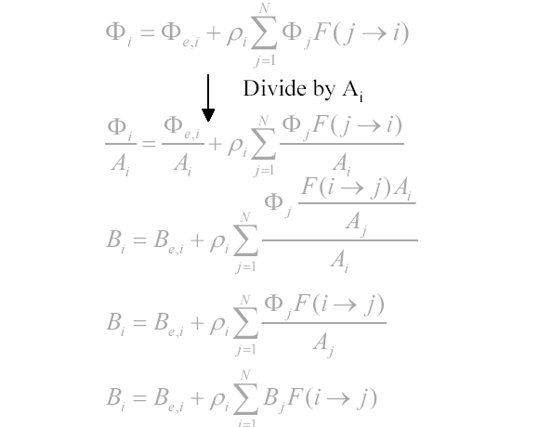
Computing Radiosity

Slide 17
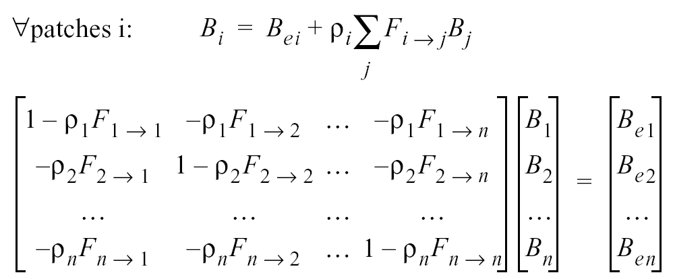
Form Linear System of Radiosity Equations
Known
Known
Unknown

Slide 18
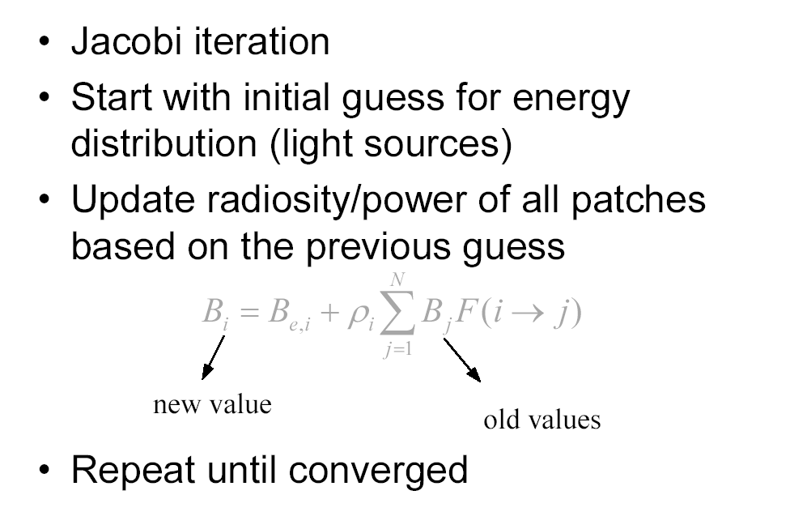
Solving the System

Slide 19
Solving the System
In general, Jacobi iteration is very slow to converge
BUT
It is highly parallelizable (how?)
In the case of radiosity, the reflectivities are in [0,1]
….which greatly speeds convergence
Should converge in only a few iterations

Slide 20
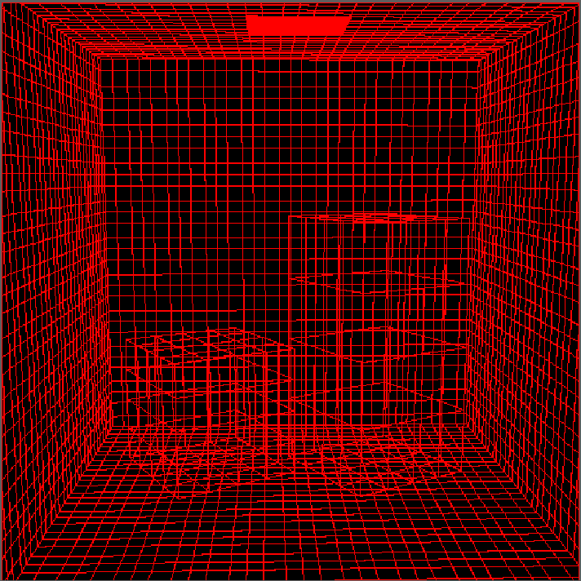
Wireframe

Slide 21
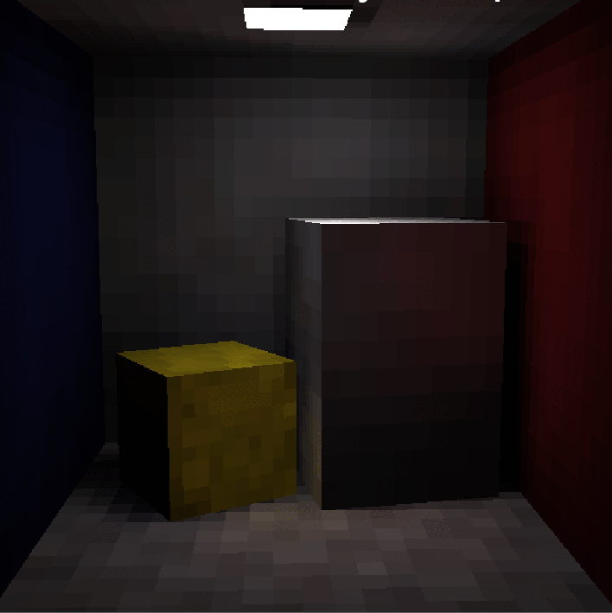

Slide 22
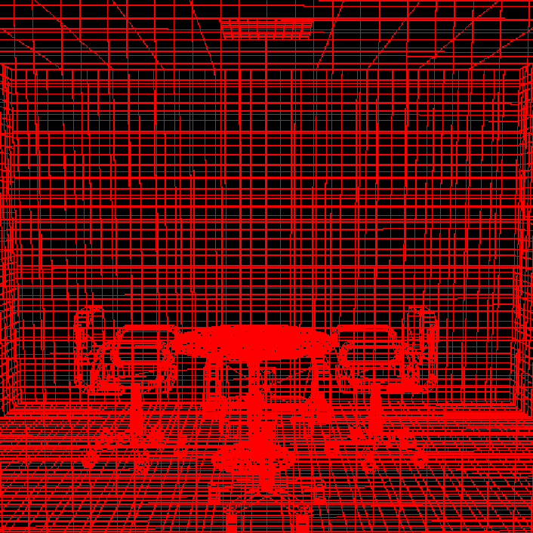
Wireframe

Slide 23
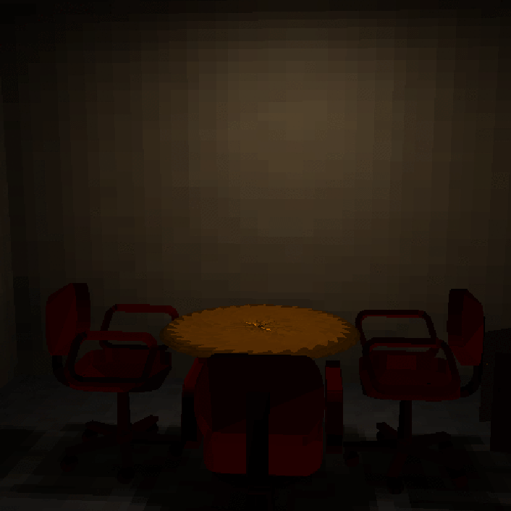
Classical
Approach
Low Res

Slide 24
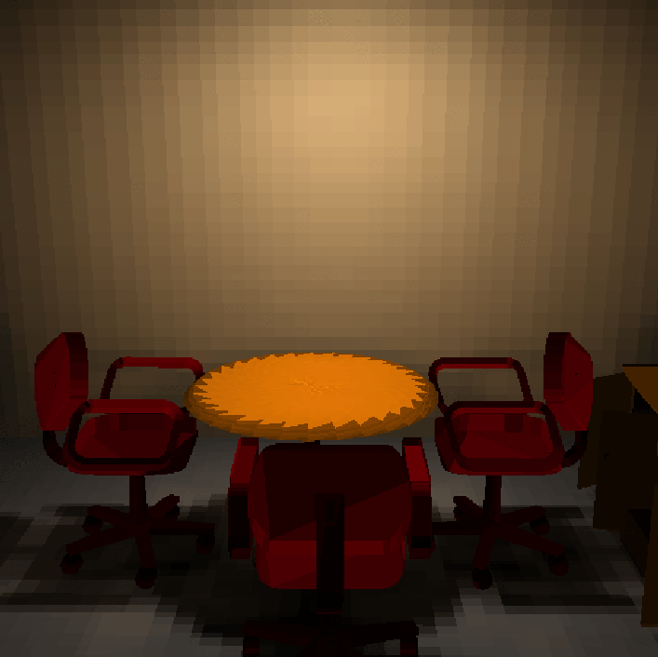
Classical
Approach
High Res
More accurate

Slide 25
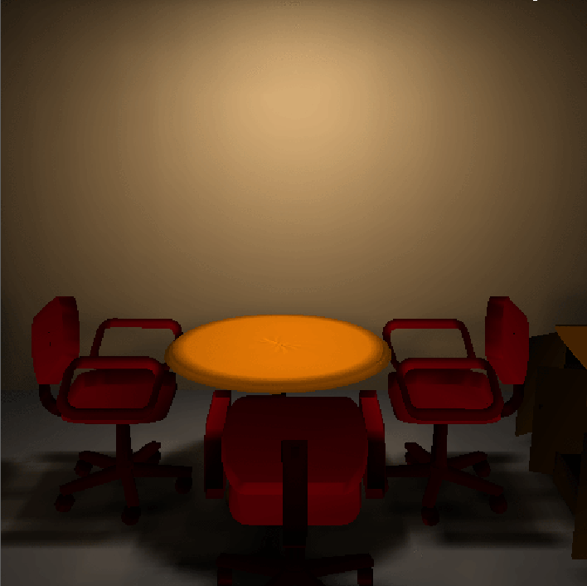
Classical
Approach
High Res
Interpolated

Slide 26
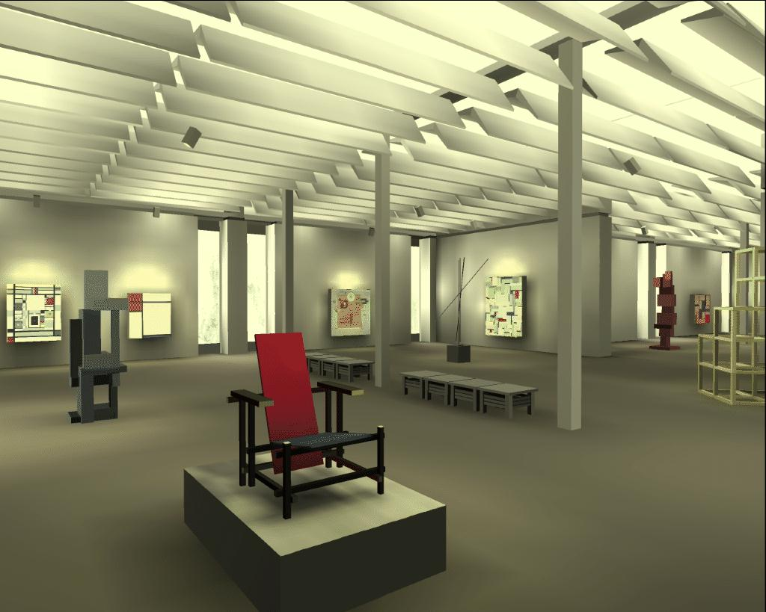
Sample Scenes

Slide 27
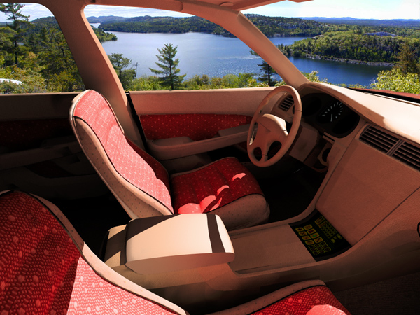
Sample Scenes

Slide 28
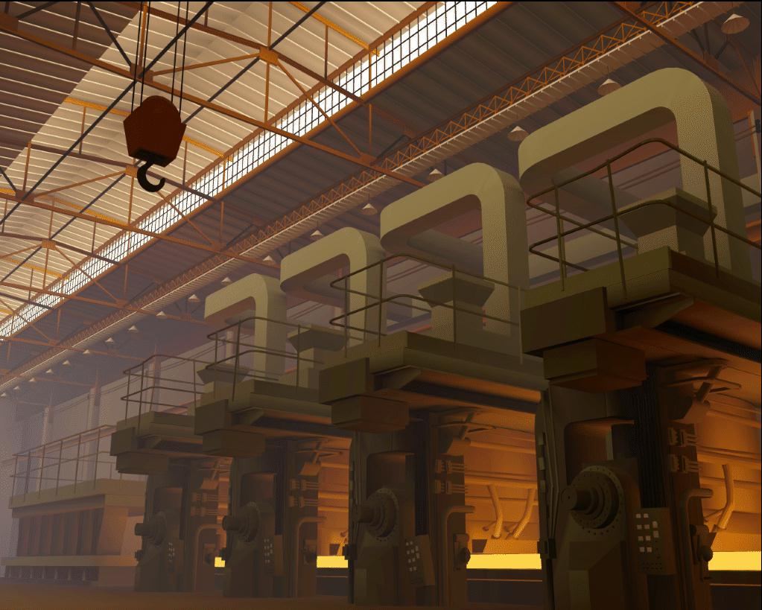
Sample Scenes

Slide 29
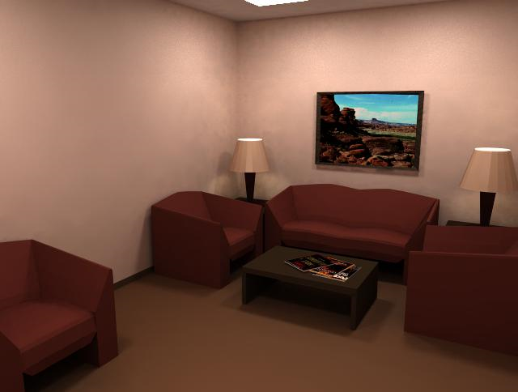
Sample Scenes

Slide 30
Radiosity: Summary
Classic Radiosity = finite element method
Assumes
Diffuse reflectance
Polygonal surfaces
Advantages
View independent solution
Can pre-compute for a set of light sources
Excellent for walkthroughs

Slide 31
Combining Ray-Tracing and Radiosity
First Pass: Diffuse Inter-reflections
View independent, global diffuse illumination
computed with radiosity.
Second Pass: Specular Inter-reflections
View dependent, global specular illumination
computed with ray-tracing.
Combine strengths of radiosity and ray-tracing.

